Slide 1
Sorting Algorithms
Computer Science, Purdue University
Copyright WILEY, Goodrich and Tamassia, Data Structures And Algorithms

Slide 2
Sorting Algorithms
Sorting Algorithms
Insertion Sort
Merge Sort
Quick Sort
Counting Sort
Computer Science, Purdue University

Slide 3
Sorting Algorithms
QuickSort
Divide : If the sequence S has 2 or more elements, select an element x from S to you pivot. Any arbitrary element, like the last, will do. Remove all the elements of S and divide them into 3 sequences:
L, holds S’s elements less than x
E, holds S’s elements equal to x
G, holds S’s elements greater than x
Recurse: Recursively sort L and G
Conquer: Finally, to put elements back into S in order, first insert the elements of L, then those of E, and those of G.
Computer Science, Purdue University

Slide 4
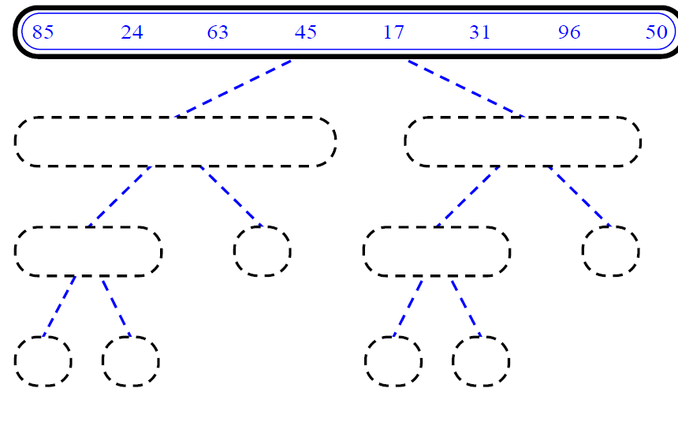
Sorting Algorithms
QuickSort
Computer Science, Purdue University

Slide 5
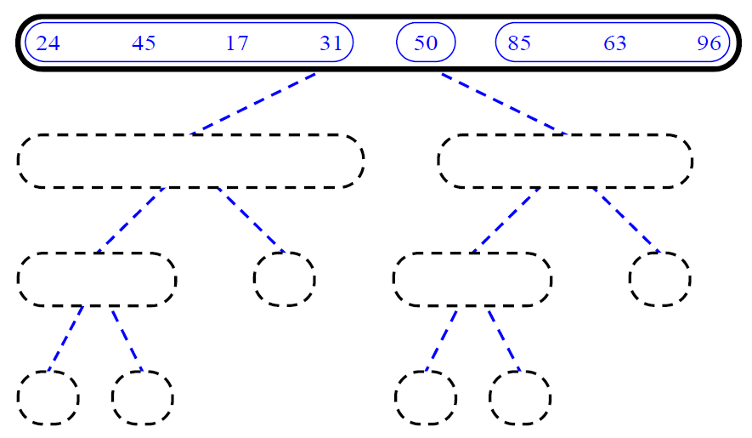
Sorting Algorithms
QuickSort
Computer Science, Purdue University

Slide 6
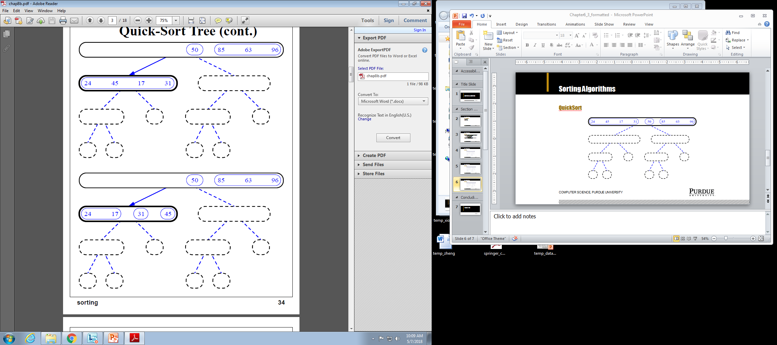
Sorting Algorithms
QuickSort
Computer Science, Purdue University

Slide 7
Sorting Algorithms
QuickSort
Computer Science, Purdue University

Slide 8
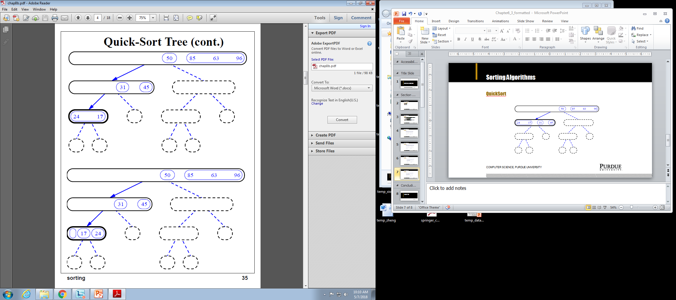
Sorting Algorithms
QuickSort
Computer Science, Purdue University

Slide 9
Sorting Algorithms
QuickSort
Computer Science, Purdue University

Slide 10
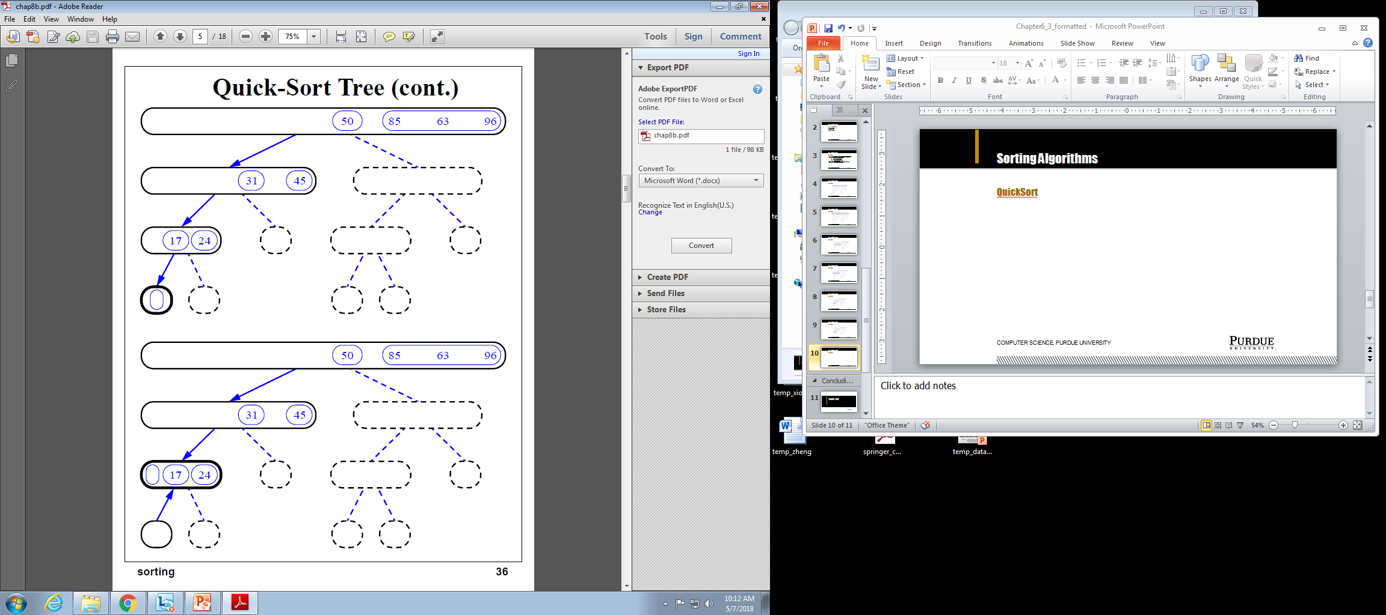
Sorting Algorithms
QuickSort
Computer Science, Purdue University

Slide 11
Sorting Algorithms
QuickSort
Computer Science, Purdue University

Slide 12

Sorting Algorithms
QuickSort
Computer Science, Purdue University

Slide 13
Sorting Algorithms
QuickSort: Runtime
Consider a quick-sort tree T:
Let si(n) denote the sum of the input sizes of the nodes at depth i in T.
We know that s0(n) = n since the root of T is associated with the entire input set.
Also, s1(n) = n - 1 since the pivot is not propagated.
Thus: either s2(n) = n - 3, or n - 2 (if one of the nodes has a zero input size).
Computer Science, Purdue University

Slide 14
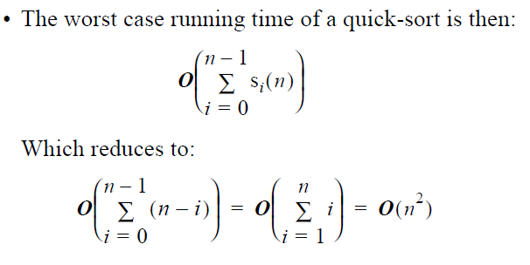
Sorting Algorithms
QuickSort: Runtime
Computer Science, Purdue University

Slide 15
Sorting Algorithms
QuickSort
Now to look at the best case running time:
We can see that quicksort behaves optimally if, whenever a sequence S is divided into subsequences L and G, they are of equal size.
More precisely:
- s0(n) = n
- s1(n) = n - 1
- s2(n) = n - (1 + 2) = n - 3
- s3(n) = n - (1 + 2 + 22) = n - 7
...
- si(n) = n - (1 + 2 + 22 + ... + 2i-1) = n - 2i + 1
...
This implies that T has height O(log n)
Best Case Time Complexity: O(nlog n)
Computer Science, Purdue University

Slide 16
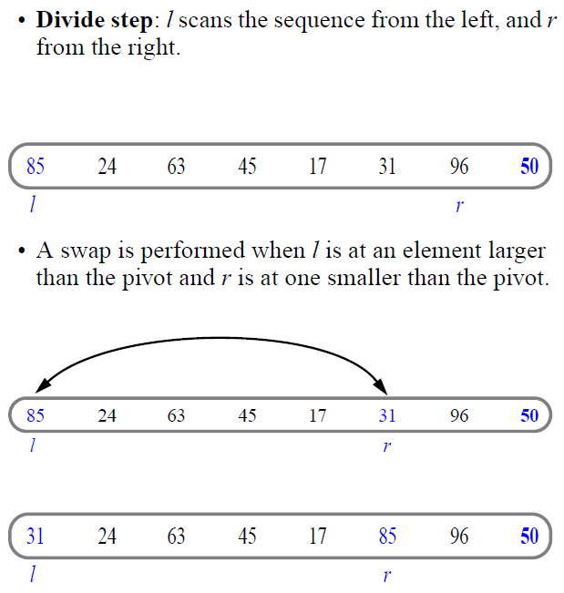
Sorting Algorithms
In Place QuickSort
Computer Science, Purdue University

Slide 17
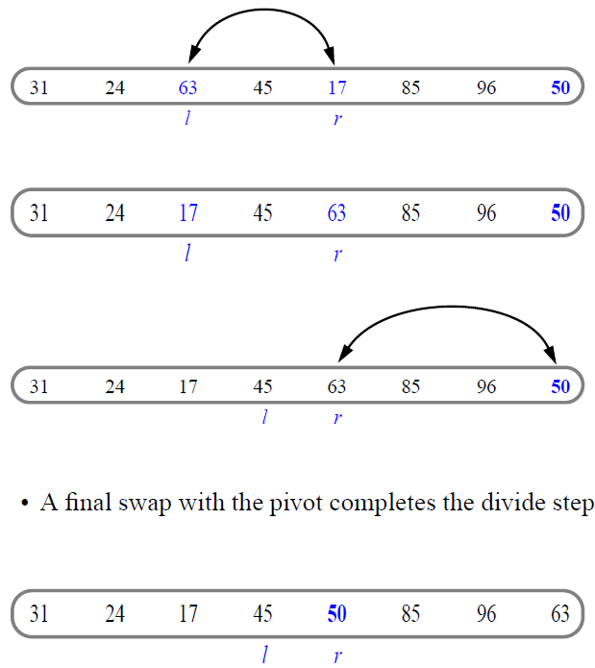
Sorting Algorithms
In Place QuickSort
Computer Science, Purdue University

Slide 18
Sorting Algorithms
Comparison-Based Sorts: How Fast Can We Sort?
Proposition: The running time of any comparison based algorithm for sorting an n-element sequence S is W(nlog n).
Justification:
The running time of a comparison-based sorting algorithm must be equal to or greater than the depth of the decision tree T associated with this algorithm.
Each internal node of T is associated with a comparison that establishes the ordering of two elements of S.
Thus every external node of T represents a distinct permutation of the elements of S.
Hence T must have at least n! external nodes which again implies T has a height of at least log(n!)
Since n! has at least n/2 terms that are greater than or equal to n/2, we can see:
log(n!) log(n/2)n/2 = (n/2)log(n/2)
Total Time Complexity: W(nlog n).
Computer Science, Purdue University

Slide 19
Thank You

